Slide 1
Morphological analysis.
Diego Alejandro Zorrilla

Slide 2
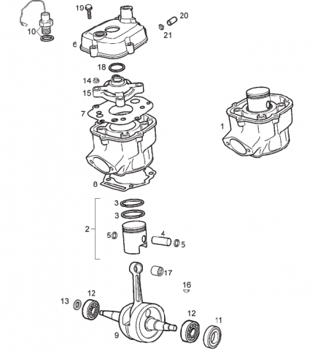
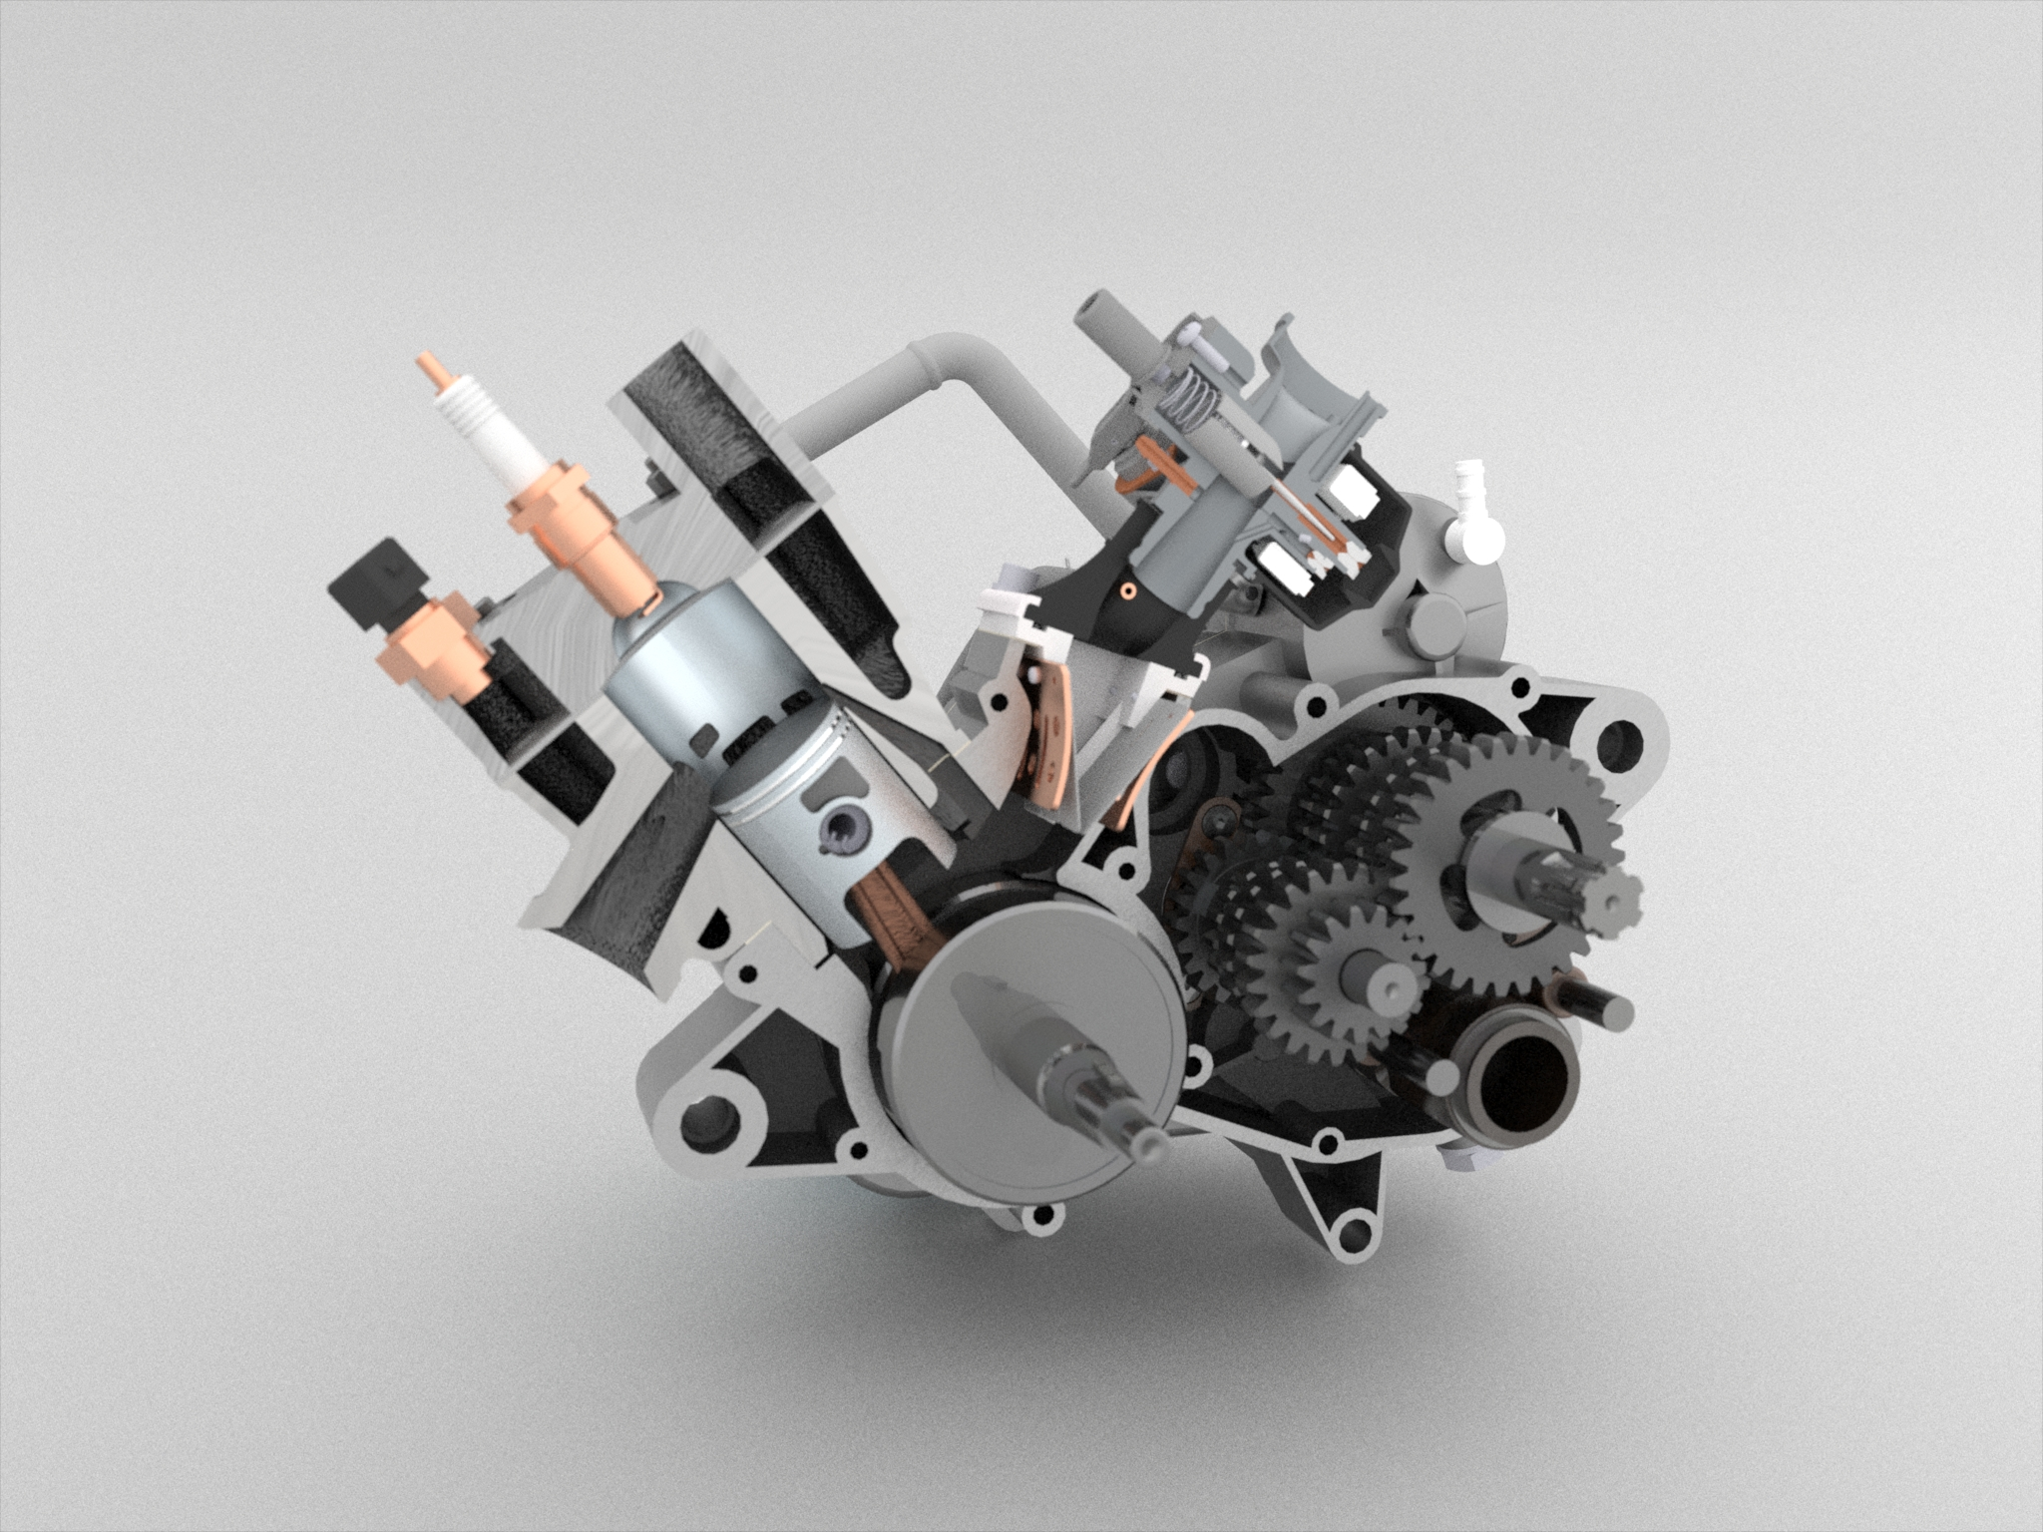
What is morphological analysis?
It is based on the conception that any object is composed of a certain number of elements, which can be isolated because they have their own identity.

Slide 3
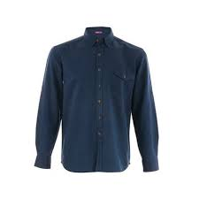
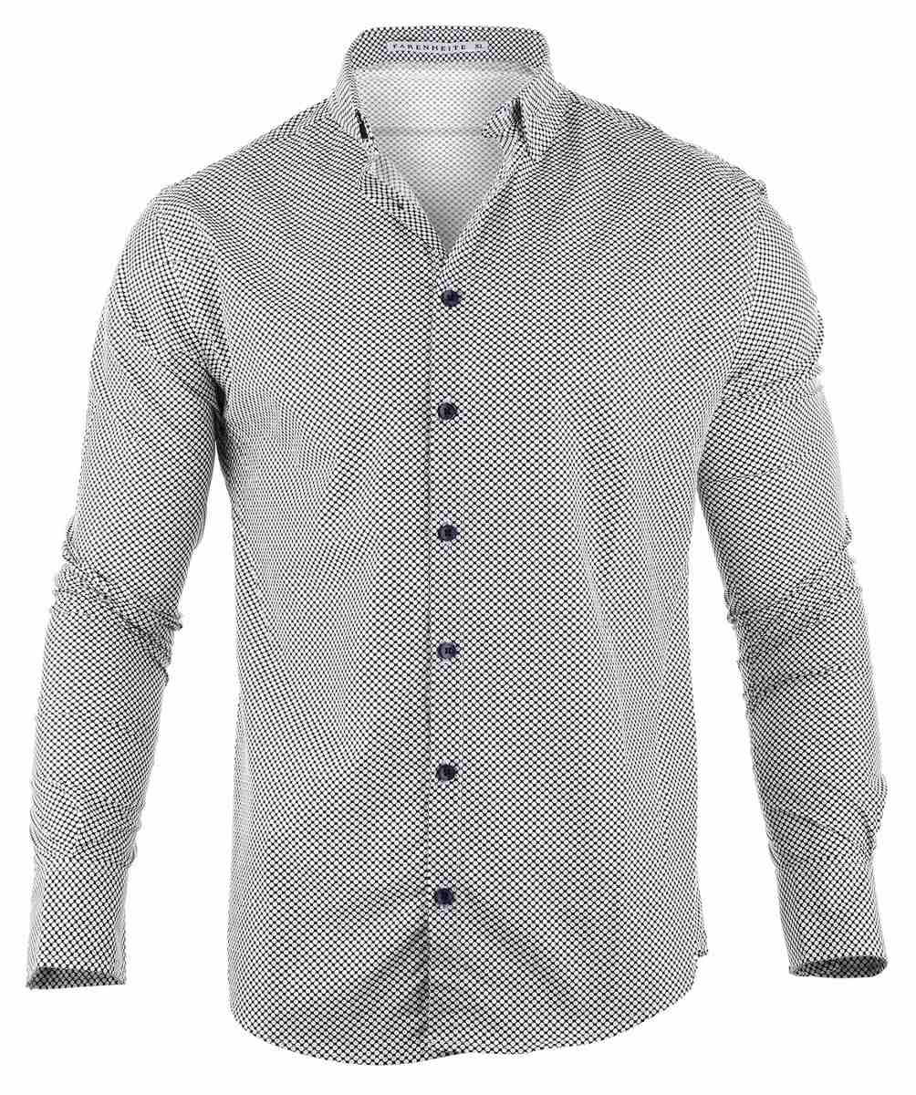
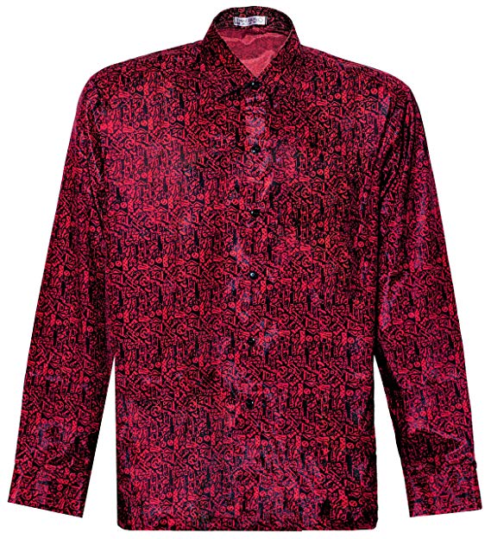
For example, a shirt: One of its functions is “Dress up”, if we take this as its sole function.
Sub-Function | Implementations |  |  | POSSIBLE COMBINATIONS | Selección
Thermal protection | Cotton | polyester | silk | 3 | 3

Slide 4
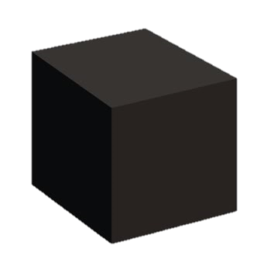
BLACK
BOX
Electric power (current)
Light
Bluetooth signal
Radio frequency signal
Location
Human action
Heart rate
Monitor patients whith
senile dementia
Location
Hour

Slide 5
Electric power.
Light.
Human Action
Allow chemical
reaction.
Allow electric current flow.
Generate periodic signal.
Divide signal at lower frequencies.
Show time in seconds, minutes and hours.
Hour
Emit Light
Receive reflected light
Determine beats per minute
Evaluate beats per minute.
Show heart rate
Send bluetooth signal
Bluetooth signal
Heart rate
Receive radiofrequency signal from satellites.
Detect first satellite.
Detect second satellite
Determine longitude and latitude in the earth
Detect third satellite
Measure satellie distance.
Location
Detect fourth satellite
Show location
TRANSPARENT
BOX
Radio frequency signal
Location.

Slide 6
Monitor patients with senile dementia
Hold the sensors
Allow chemical reaction
Generate periodic signal
Show time en seconds, minutes and hours
Receive reflected light.
Evaluate beats per minute
Send bluetooth signal
Detec satellites
Determine longitude and latitude on earth.
Transform current
Grab device
Allow flow of electric current.
Divide signal at lower frequencies.
Determine beats per minute
Receive radiofrecuency signal from the satellite
Measure distance to the satellite
Emiti light
Show hear rate
Show Location
- USB charger
- Fast charge
-Universal charger
-Dip switch
-Button
-Miniature switch
-Crystal oscillator.
-Harmonic oscillator
-Adapter of time
-Hototransistors
-Fododiodes -LDR
Module hc06 Module hc05
-Synchronous counter
-Asychronous counter
-LED RGB -LED Smart
-KY 039
-06 Raspberry Analogue ciruit.
GPS neo 6N SIM 800 GSM
-Silicone rubber strap.
-Movable tape.
-Copper-Nickel
-Silver
-Copper
-Nickel
-Display LCD graphic.
-Display of segments
-Display of projection -Display of matrix.
Create electrical signal with precise frequency
Allow light passage
Execute mathematical operations
-Magnectic chucks.
-Velcro.
-Buttons
Transmit and receive mobile application information
Allow electron flow
Execute mathematical operations
Define shape of the electrodes
-Crystal vibratory
-Electronic amplifier
-Chip-reflector
-Chip LED_20W
-Broatcom
-Atmel ATR
-PIC
-Liquid of the display
-Glow lamps
FUNCTIONS AND MEDIA TREE

Slide 7
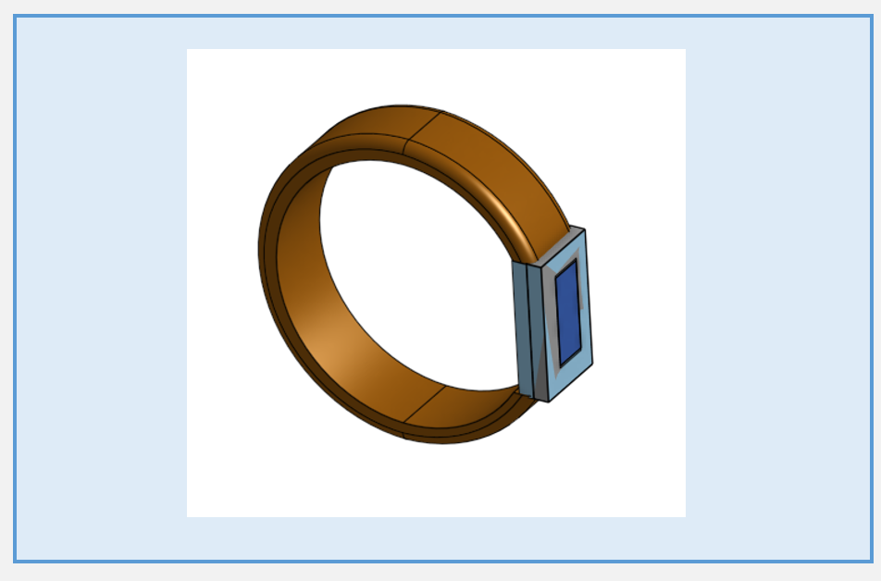
Product
3D prototype.

Slide 8
SUBFUNCTIONS | implementations |  |  |  | POSSIBLE COMBINATIONS | SELECTION
Transform current to power device | USB charger | Fast charge | Universal charger |  | 3 | 1
Fasten the device to the wrist | Silicone rubber strap | Scrolling tape |  |  | 2 | 1
Grab device | Magnetic clamps | Velcro | Buttons |  | 3 | 1
Allow chemical reaction | DIP switch | “push-button” | Miniature switch |  | 3 | 1
Allow current flow | Silver | Copper | Nickel | Copper-Nickel | 4 | 1
Generate periodic signal | Crystal oscillator | Harmonic oscillator | Time adapter |  | 3 | 1
Divide signal at less frequency | Asynchronous counter | Synchronous counter |  |  | 2 | 1
Show time (s-min-h) | Graphic LCD display | Display de segmento | Projection display | Matrix display | 4 | 1
Emit light | LED RGB | LED Smart |  |  | 2 | 1
Receive reflected light | Phototransistor | Photodiodes | LDR |  | 3 | 1
Determinar BPM | Sensor KY039 | Sensor 06 Raspberry | Circuito análogo |  | 3 | 3
Mostrar BPM | App nativa | Web App | Web App nativa |  | 3 | 1
Send bluetooth signal | hc06 | hc05 |  |  | 2 | 1
Receive radio frequency signal
Detect satellites | GPS neo 6N | Sim800GSM GPRS |  |  | 2 | 1
Measure distance to satellites
Determine latitude and altitude longitude
Show position
Create electrical signal with precise frequency | Vibrating glass | Electronic amplifier |  |  | 2 | 1
Allow light passage | Chip-reflector | Chip LED |  |  | 2 | 1
Define shape of the electrodes | Liquid display | Incandescent lamps |  |  | 2 | 1
Execute mathematical operations | Broatcom | Atmel ATR | PIC |  | 3 | 3
Evaluate BPM
 |  |  |  |  | 26.873.856 | 27

Slide 9
Thank you!

